Slide 1
EU
Aid Volunteers
Julia Stewart-David
DG ECHO
Sophie LEMEL
EACEA
Roma, November 22nd 2016

Slide 2
Certification mechanism

Slide 3
Sending Organisations
Hosting Organsations

Slide 4
Sending Organisations
European Organisation
…active in the field of humanitarian aid
…including the International Federation of National Red Cross and Red Crescent Societies.

Slide 5
Hosting Organisations
Third country organisations
…active in the field of Humanitarian Aid
…including International agencies and organisations.

Slide 6
Administrative simplification
FPA / FAFA partners are exempt from:
Proof of eligibility
Proof of being active in humanitarian aid
Proof of compliance with equal opportunities and non-discrimination standard
Proof of compliance with safeguarding children and vulnerable adults standard

Slide 7
What is a complete application?

Slide 8
Sending organisation
Evidence-based self-assessment form
Declaration on honour
Security check-list
Proof of experience in the field of humanitarian aid
Mandatory evidence documents for the following requirements:
Security policy and risk assessment
Equal opportunities and non-discrimination
Safeguarding children and vulnerable adults
Health and safety
Data protection
Optional evidence

Slide 9
Hosting organisation
Self-assessment form
Declaration on honour
3 references
Hosting organisation simplified procedure
Self-assessment form
2 types of declaration on honour
3 references

Slide 10
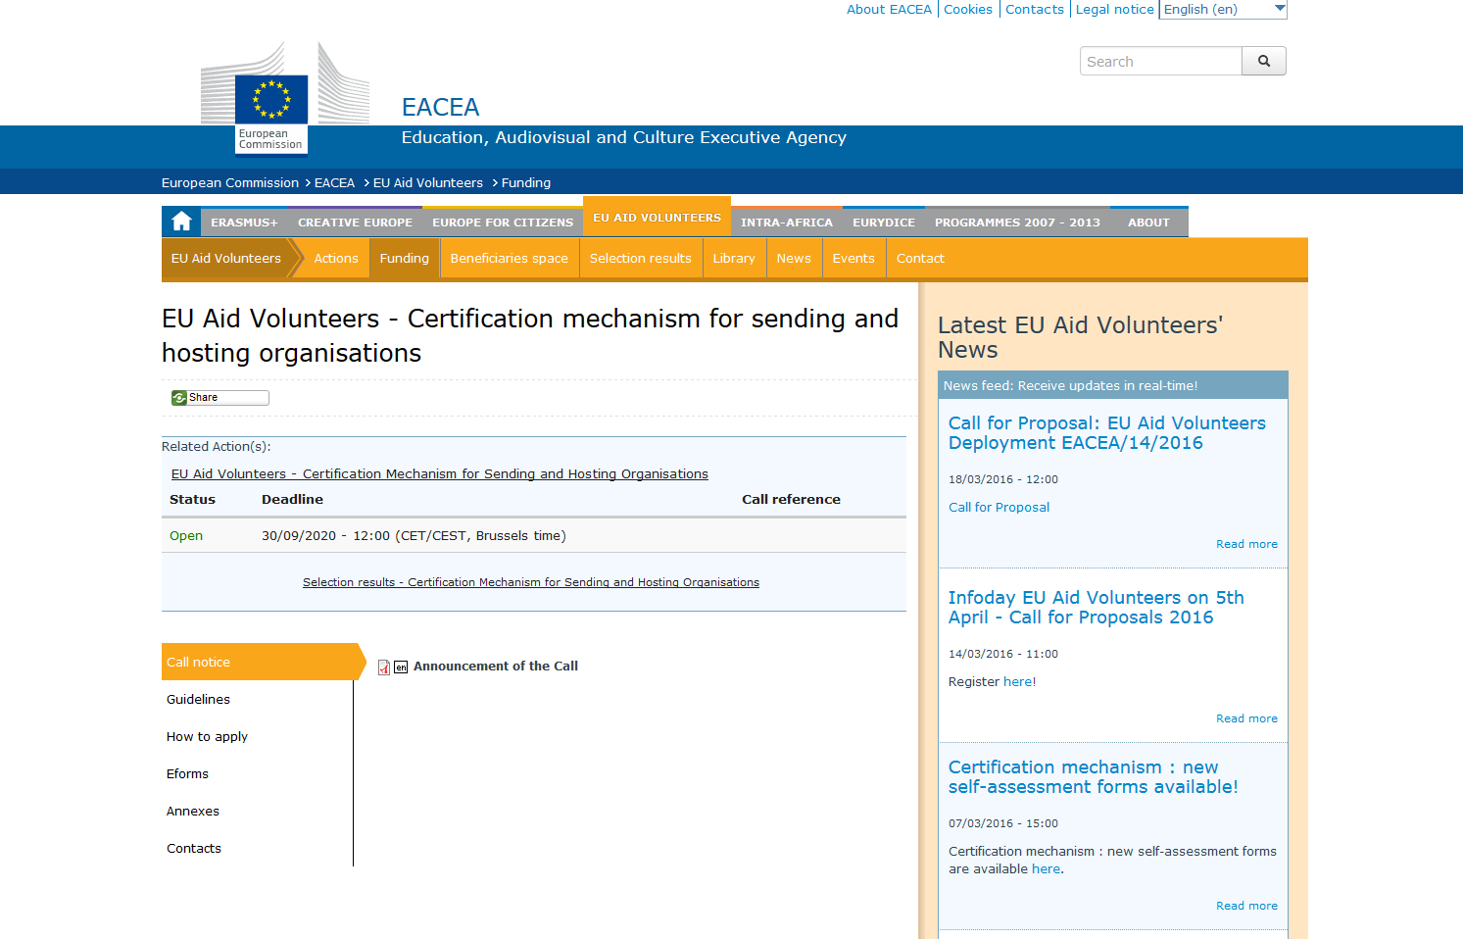

Slide 11
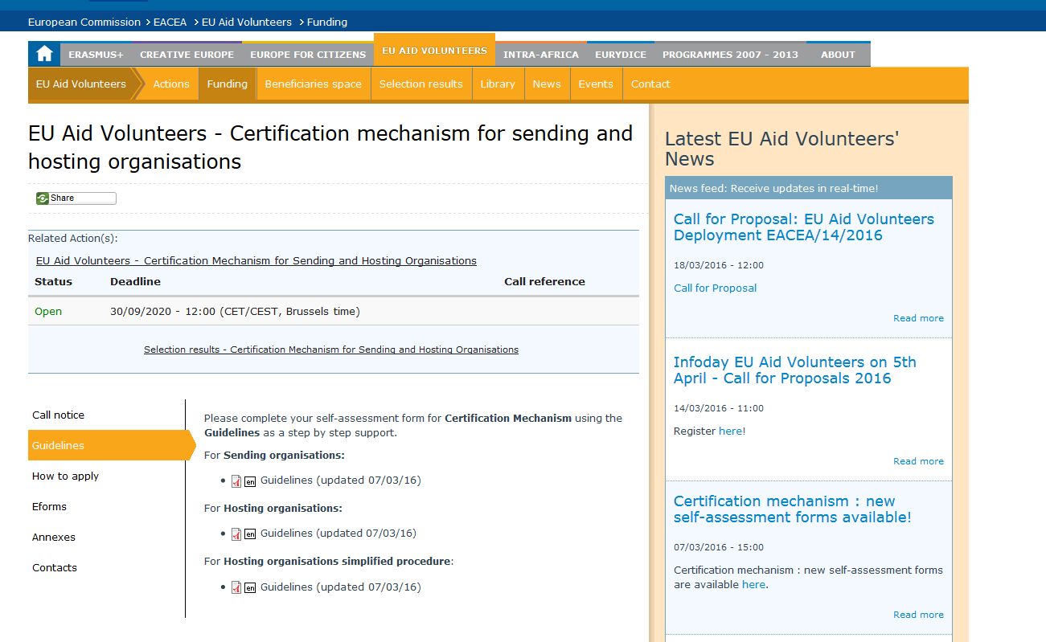

Slide 12
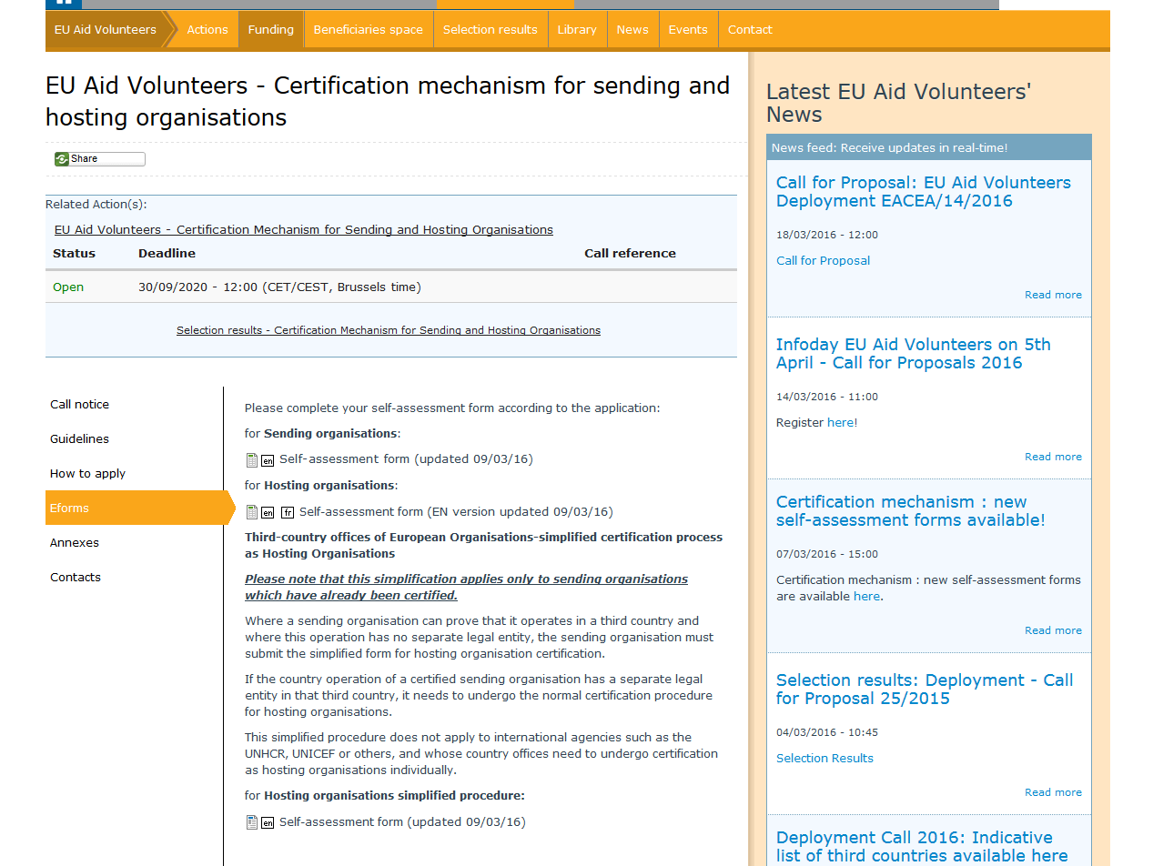

Slide 13
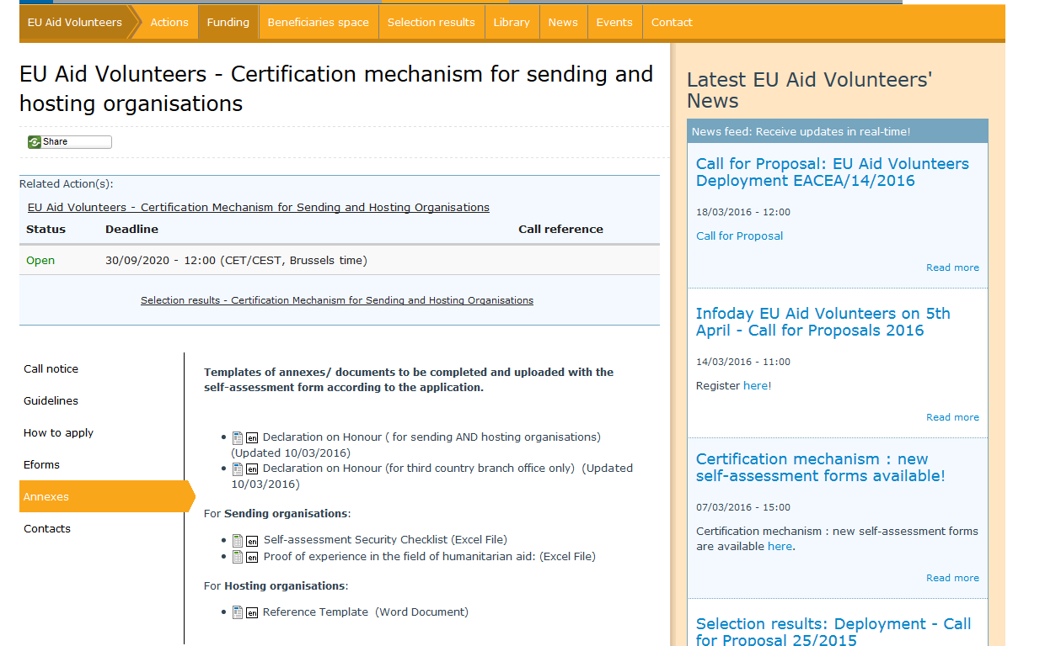

Slide 14
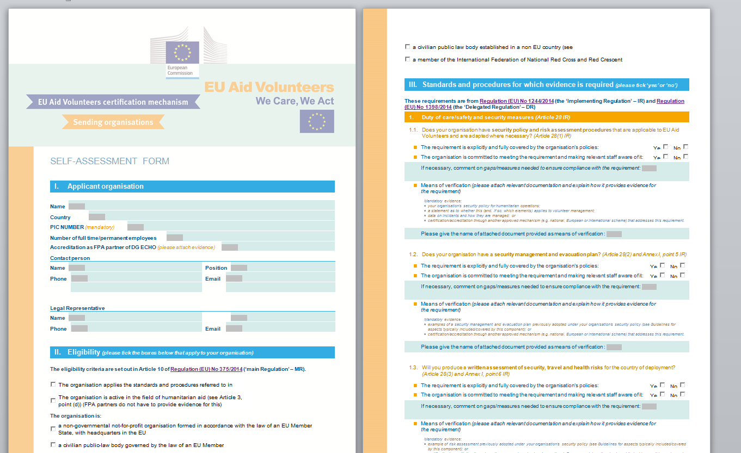

Slide 15
The most frequent errors
Application form is not complete
Some mandatory documents are missing
Documents sent with the application are not relevant or do not explain the procedures/policies of the organisation
No documents uploaded for PIC number

Slide 16
Results
Communication of results within 6 months of receiving application:
Organisations not awarded for certification:
Not fully compliant with the requirement of the standards and procedures
Written notification indicating reasons and who to contact for further information
Organisations awarded certification:
Fully compliant with the requirements of the standards and procedures
Written confirmation
Published list
Organisations awarded certification:
Fully compliant with the requirements of the standards and procedures
Written confirmation
Published list
Organisations not awarded for certification:
Not fully compliant with the requirement of the standards and procedures
Written notification indicating reasons and who to contact for further information
Next step: available support for technical assistance and capacity building.

Slide 17
Where to find the information?
EACEA Website
http://eacea.ec.europa.eu/eu-aid-volunteers/funding/certification-mechanism-for-sending-and-hosting-organisations_en
Any doubts or questions?
EACEA-EUAID-VOLUNTEERS@ec.europa.eu

