Slide 1
EU
Aid Volunteers
Juila Stewart-David
DG ECHO
Sophie LEMEL
EACEA
Roma, November 22nd 2016

Slide 2
Why EUAV?
Solidarity - responding to the requests of EU citizens to support those most in need in the world
Increasing number of natural and man-made disasters - more efforts needed to prevent hazards becoming disasters
Need for more trained and well prepared people to support local organisations and communities
Support for improvements in the humanitarian sector - need for a stronger more robust system

Slide 3
What is EUAV?
An opportunity for well trained and well prepared junior and senior humanitarian volunteers from the EU to help local communities in third countries
Based on concrete humanitarian needs and gaps identified jointly by sending organisations in Member States and hosting organisations in third countries
Providing technical assistance and capacity building for humanitarian organisations themselves – both sending and hosting - strengthening the system

Slide 4
Pilot phase 2011-2014
12 pilot projects in three phases funded under the action 300 volunteers deployed in 49 third countries
Lessons learnt:
Demand for humanitarian professionals
Demand for specific skills
Training provision central
Need for establishment of volunteer management standards
Demand for capacity building of local organisations to ensure lasting impact of the work

Slide 5
Legal basis
Regulation 375/2014
Implementing Regulation 1244/2014
Delegated Regulation 1398/2014
Volunteer management procedures
Training programme
Certification mechanism
Standards on recognition, equal opportunities, partnerships and the competence framework

Slide 6
What does the programme offer?
Capacity
Building
Certification
Communication Outreach
Technical
Assistance
Deployment of Volunteers
Training /
Apprenticeships
Online
Volunteering
EUAV Platform
Insurance for Volunteers

Slide 7
Benefits
for organisations
Human Capital - investment in the professionalization of the sector
Focus on resilience building and preparedness
Partnerships, information sharing, knowledge transfer
Additional Complimentary Funding Resource

Slide 8
Volunteers
From Member States – age 18 or over – junior and senior volunteers - placements from 1 to 18 months
Flights, accommodation, subsistence allowance and insurance provided – safety and security a priority - no deployment to conflict areas
Mandatory training and possibility of 6 months apprenticeship for junior volunteers
Vacancies for specific profiles following needs assessment - online volunteering also possible

Slide 9
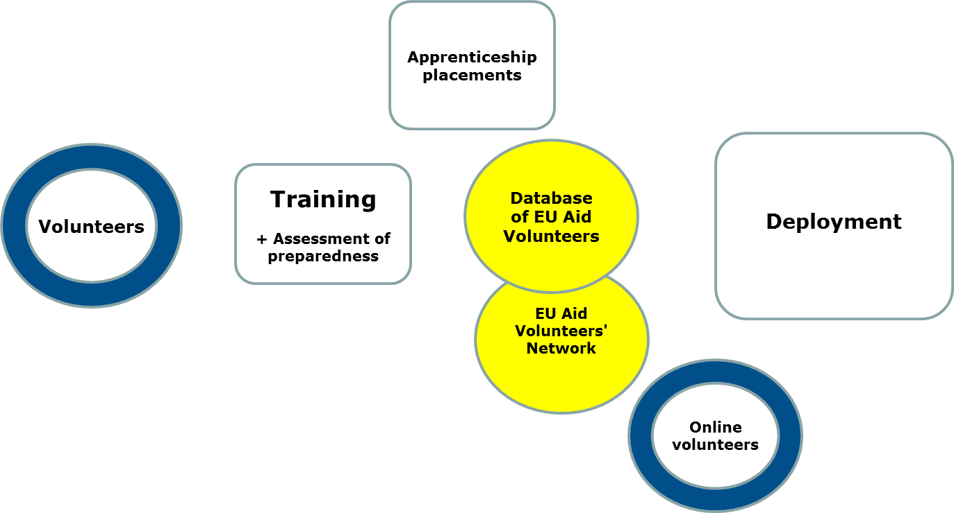
Volunteers
Deployment can be short or long -term depending on the project and the volunteer's profile; a volunteer can be deployed more than once.
The 'Network' brings together all volunteers for alumni type activities – also the local staff and volunteers from the capacity building projects
Volunteers apply for participation based on call for vacancies published on EU Aid Volunteer platform by certified sending organisations
After successfully passing training they become 'EU Aid Volunteers' and are included on the Database; they can now be sent to hosting organisations
Volunteers are selected by the consortium of sending & hosting organisations, based on need identified. Prior EU training takes place; modules tailored to profile & placement.
Online volunteers contribute to the deployment projects; they offer to coach volunteers or to help out with other tasks they can do on their computer

Slide 10
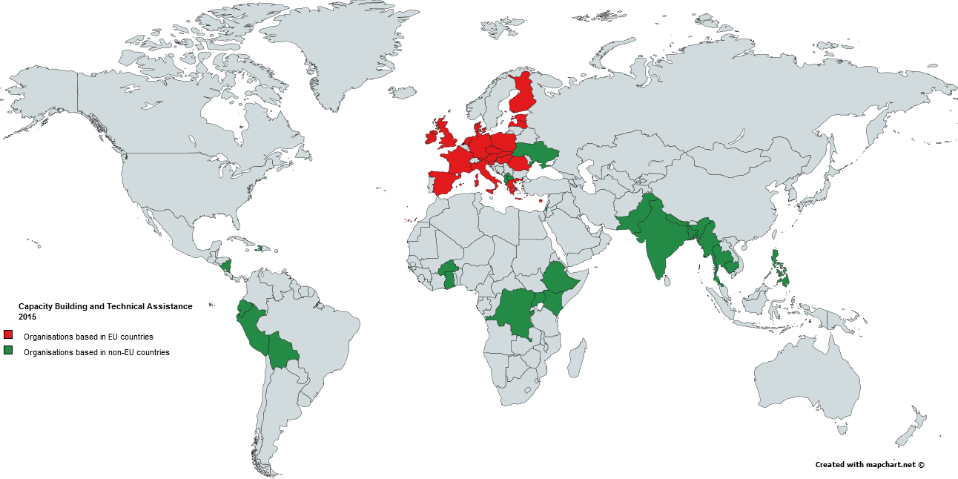
Capacity Building &
Technical Assistance in 2015

Slide 11
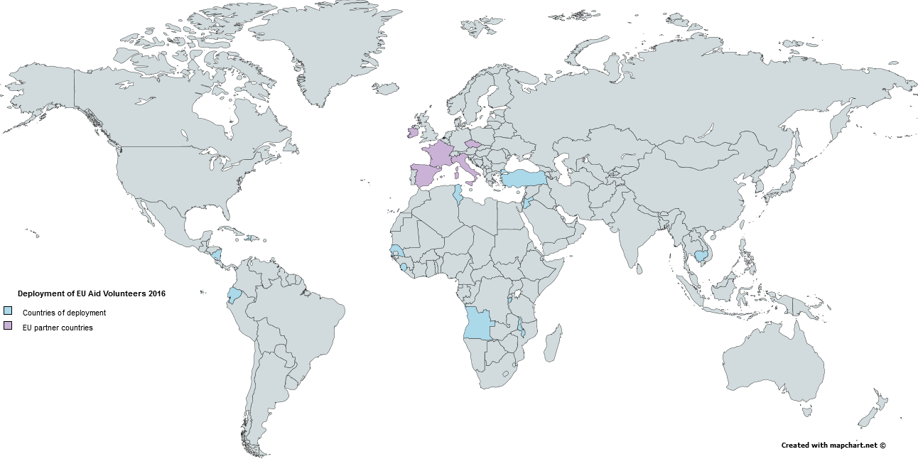
Deployment of EUAV in 2016

Slide 12
...in partnership with…EACEA
Project Selection & Management
Calls for proposals:
1) Technical assistance and capacity building
2) Deployment
Calls for tenders:
1) Training
2) Insurance
Project Monitoring

Slide 13
Opportunities
Certification leading to :
Deployment of EU Aid Volunteers
Capacity building - Technical assistance
Funding at 85% of total project costs

Slide 14
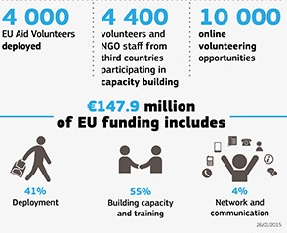
2015-2020 Opportunities

Slide 15
Certification

Slide 16
Certification
Sending organisations
…including the International Federation of National Red Cross and Red Crescent Societies
…active in the field of humanitarian aid
EU organisations

Slide 17
Certification
Hosting organisations
…including international agencies and organisations
Third country organisations
…active in the field of humanitarian aid

Slide 18
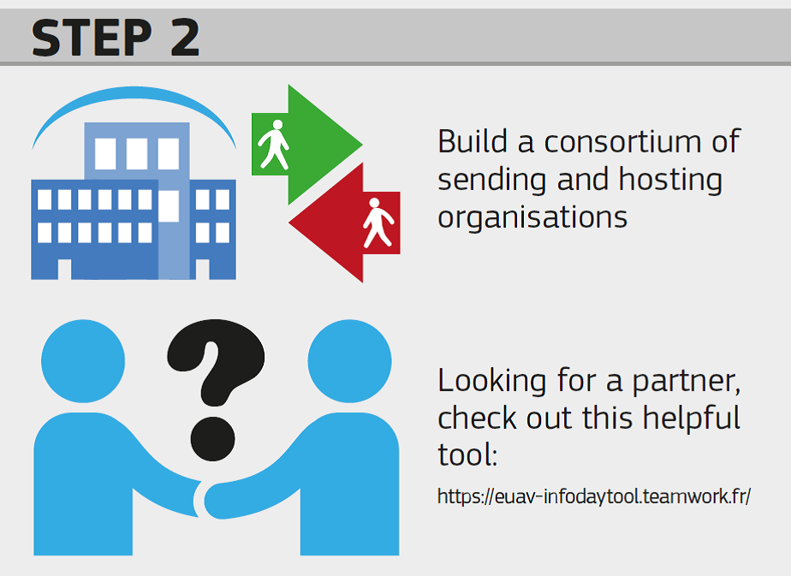
Consortium Building

Slide 19
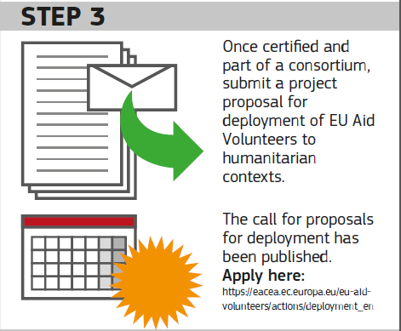
Submit Proposal

Slide 20
Technical assistance and capacity building
Deadline and eligibility criteria : change every year. Example of the 2016 Call
Objective: Strengthening the capacities of sending and hosting organisations intending to participate in the initiative and ensuring compliance with the standards and procedures.
Partnership for TA: organisations from ≥ 3 EU countries; applicant active in the humanitarian aid field for at least 3 years; applicant or one of partner active in the volunteer management for at least 3 years;
Partnership for CB: organisations from ≥ 3 EU countries and ≥ 3 third countries in which humanitarian aid take place; all EU organisations active in the humanitarian aid field for at least 3 years; at least 2 third countries' organisations are active in the humanitarian aid field; applicant or one of partner active in the volunteer management for at least 3 years;

Slide 21
Deployment
Deadline and eligibility criteria : change every year. Example of the 2016 Call
Activities: Selection, recruitment, preparation and deployment of EU Aid Volunteers, capacity building and technical assistance for sending and hosting organisations
Partnership: ≥ 2 certified sending organisations from 2 different countries and ≥ 2 certified hosting organisations; may include other partner organisations specialised in any areas relevant to the objectives or the actions of the project and associates
Volunteers: junior or senior professionals (more than 5 years' experience
Apprenticeship (junior professionals): in one of the participating EU Member States for max. 6 months
List of priority countries for 2016 for deployment and capacity building in third countries

Slide 22
CONTACT AND SUPPORT
EU-AID-VOLUNTEERS@ec.europa.eu
EACEA-EUAID-VOLUNTEERS@ec.europa.eu

